Slide 1

Law Network
We will give you proper solution of cases!

Slide 2
Objectives
01
02
04
05
03
Introduction
About App
App intro
Brief description of Law
Introduction of our team
Specifications of our project
06
Snapshots
Work division
Experience
Visual intro and flow of our Website
Workdone by each Student
Overall e-project experience

Slide 3
Introduction of Team…
Muhammad Tayyab Fiasal
Shoaib
MuhammadHaris
Dania
Siddiqui
Junaid Khan
student1338679
Student1338868
Student1338683
Student1340163
Student1345297

Slide 4
About Law Network Website
Law Network is a Website To help people know the laws and solve their respective cases.
User has to be register to avail the Website benefits.
User has been provided an interactive Dashboard after login to his profile.
User can update his profile if he wants to do.
There is catagories of Different Lawyers like Divorce Case Murder Case etc.
Users Will be Appointed Top Quality Lawyer According to his/her case.
User can search through recipe type and also by ingredients.
User can view all the Category Of Lawyers and their complete details.
User Can book an Appointment With our lawyers and share his matters.

Slide 5
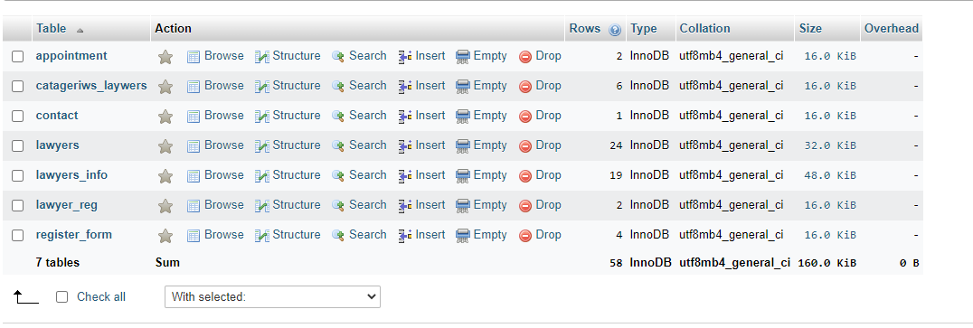
This is our Database which includes all of the data.
Our Database

Slide 6
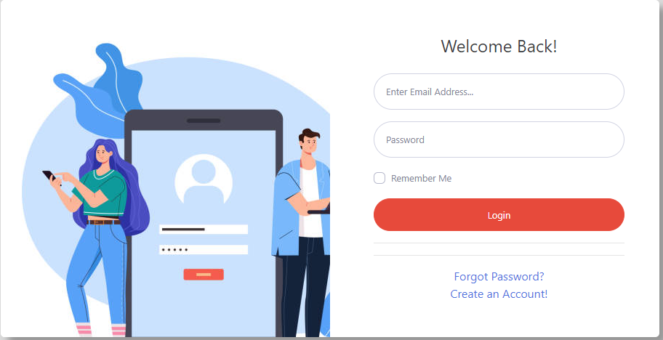
Login Tab
Here is the login tab fragment, having an attractive visual interface.

Slide 7
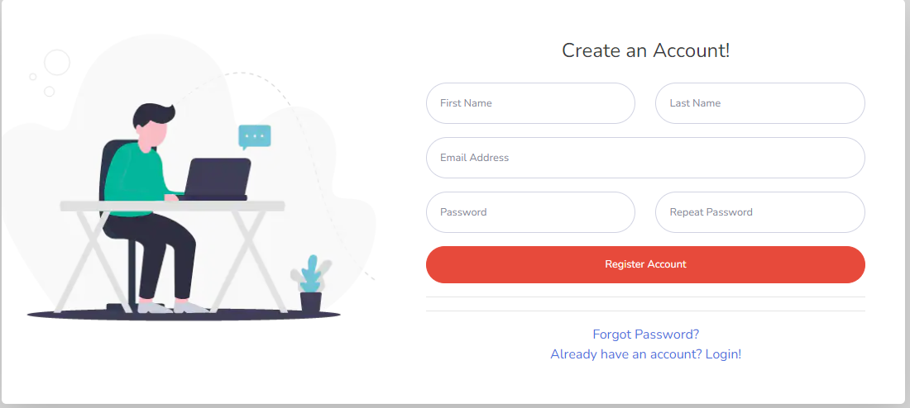
Signup Tab
Here is the Signup tab fragment, having an attractive visual interface swipe to have signup form.

Slide 8
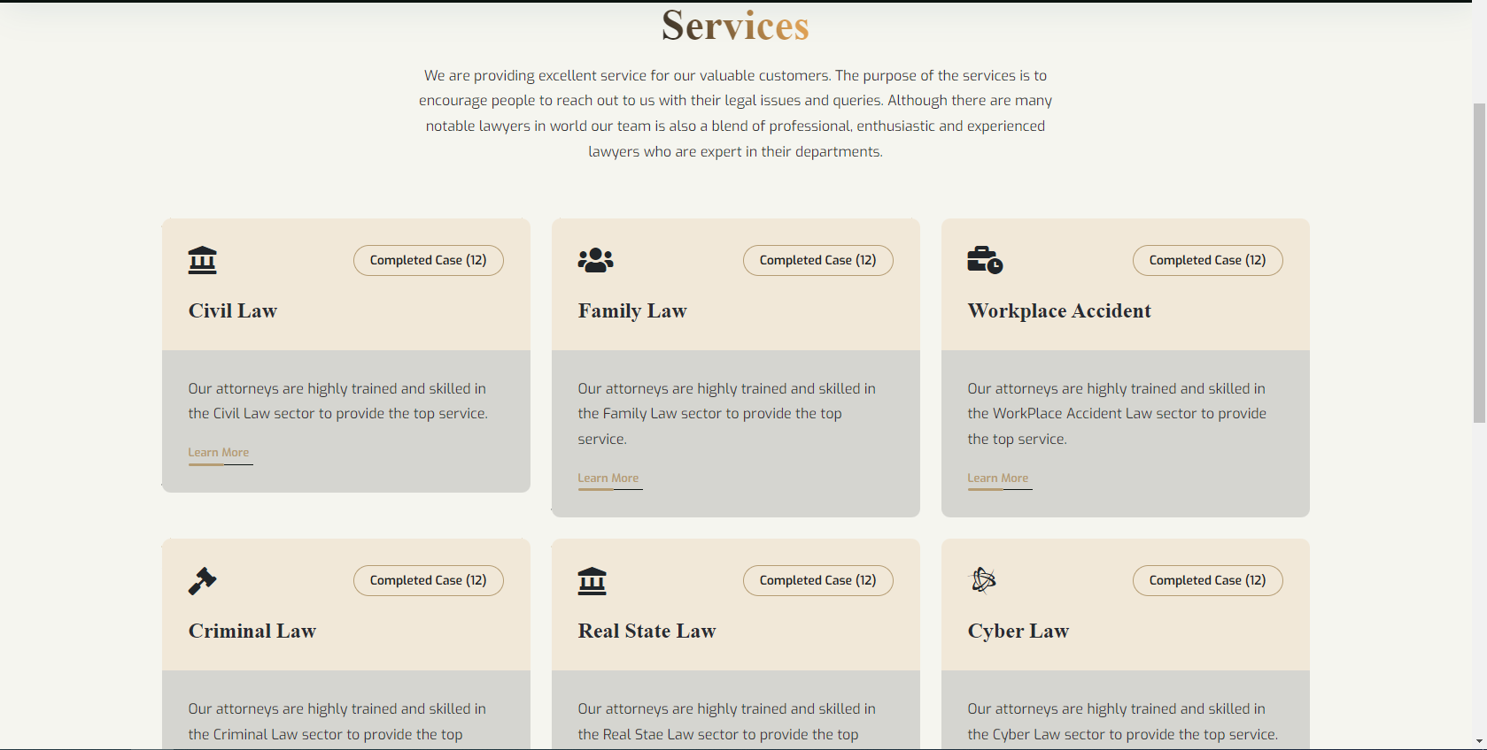
Our Services Page
This is Our services page. Showing
How much services we providing
In different ways.

Slide 9
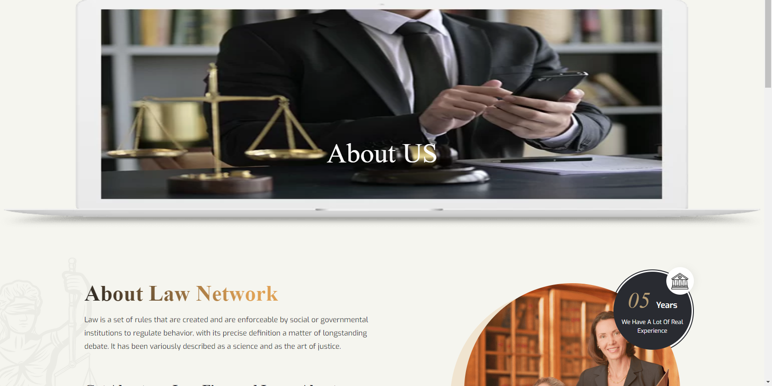
About US Page
Here is the About us page. Telling about our law firm and our law expertise we have in this field.

Slide 10
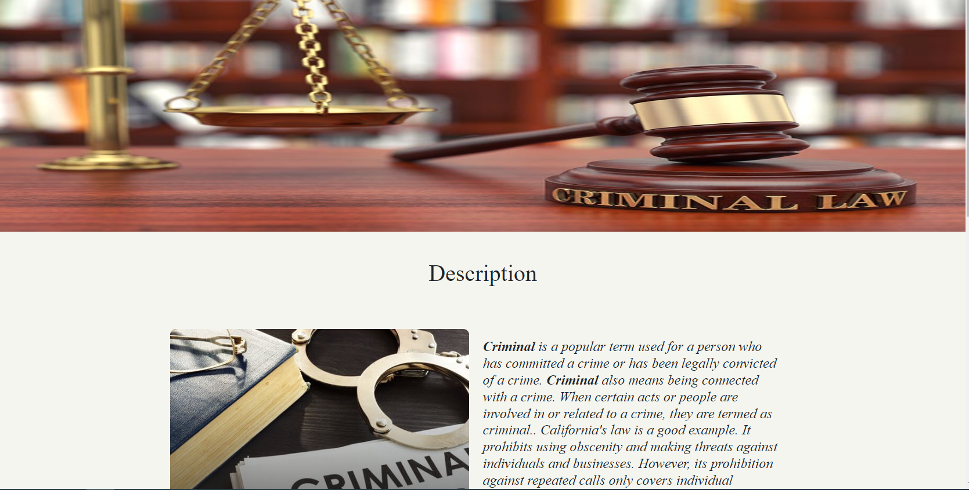
Study Case
Another page with a study case.
In this page we have told some description as well as some history about crime.

Slide 11
A Timeline Always Works Well
Week 1
Week 3
Database + ERD + Logo
Designing of each page
Week 2
Week 4
Image collection + Login+Signup
Database connectivity

Slide 12
Thank You!
Now we should go through our website!!

